Slide 1
PROGRAMMING USING PYTHON

Slide 2
CONTENTS
Introduction to python
Python IDLE usage
Print and input
Digital Café
Anaconda

Slide 3
Introduction-Python
High-level programming language
Interpreted
Interactive
Object-Oriented Programming Language

Slide 4
Why Python?
Easy to learn
Can be used in broad range of applications
Open source
Procedural, Functional, Object-Oriented

Slide 5
Evolution of Python
Developed by Guido Van Rossum in early 1990s
Named after a comedy group Monty Python
Features derived from many languages like C, C++, Java and other scripting languages
Available under GNU General Public License ( Free, Open Source)
Python 3.10.2 - 14 Jan 2022 being the latest version

Slide 6
Python Features
High Level , Interpreted , Interactive and Object Oriented Programming Language
Beginner Language
Interactive Mode
Features
Extensive Standard Libraries
Portable
Extendable
Database and GUI Programming

Slide 7
Python Installation
PYTHON DOWNLOAD: https://www.python.org/downloads/release/python-391/
PYTHON TUTOR: http://www.pythontutor.com/

Slide 8
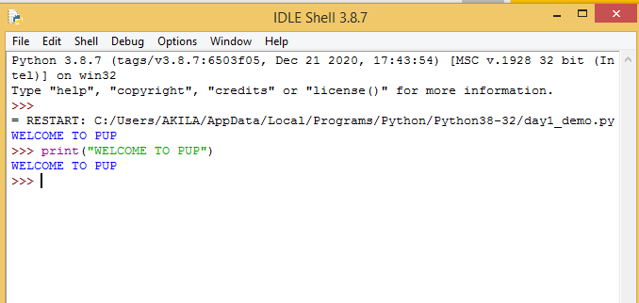
Python IDLE(Interactive interpreter)

Slide 9
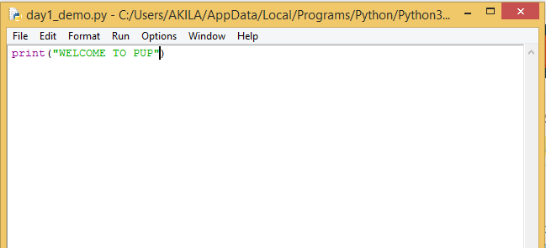
Python IDLE (File Editor)

Slide 10
Python Basics-Print statement
To display output on the screen of the user - print( )
Syntax:
print([output ])
Example code:
language=“Python”
print(language)
Output:
Python

Slide 11
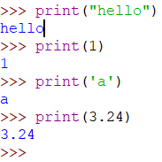
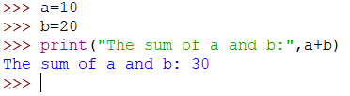

Python Basics-Print statement

Slide 12
Python Basics-User Input statement
To get user input through keyboard – input()
All inputs got from the user are treated as Strings
Syntax:
variablename = input([prompt ])
Ex:
name=input(“Enter your Name:”)
Enter your Name:

Slide 13

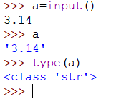

Python Basics-User Input statement

Slide 14
Python Basics-User Input statement
Example code:
number1=input(“Enter a number:”)
number2=input(“Enter another number:”)
print(“Result:”,number1+number2)
Output:
Enter a number :5
Enter another number:6
Result:56

Slide 15
Python Basics-User Input statement
Example code:
number1=int(input(“Enter a number:”))
number2=int(input(“Enter another number:”))
print(“Result:”,number1+number2)
Output:
Enter a number :5
Enter another number:6
Result:11

Slide 16
Formatting the Output
Example code:
session=“Session 1”
language=“Python”
print(session, language)
Output:
Session 1 Python

Slide 17
Formatting the Output
Example code:
print('This is an {0} for formatting the {1}'.format(‘example’, ‘output’))
Output:
This is an example for formatting the output

Slide 18
Formatting the Output
Example code:
session=“Session 1”
language=“Python”
print('This is {0}.You are learning {1}'.format(session, language))
Output:
This is Session 1.You are learning Python

Slide 19
Formatting the Output - sep
All the values are separated by blanks, which is the default behaviour.
the default value to an arbitrary string can be changed by keyword parameter "sep" of the print function:

Slide 20
Formatting the Output - sep
Example 1:
q = 459
p = 0.098
print(q, p, p * q)
Example 2:
q = 459
p = 0.098
print(q, p, p * q, sep=",")
459,0.098,44.982
459 0.098 44.982

Slide 21
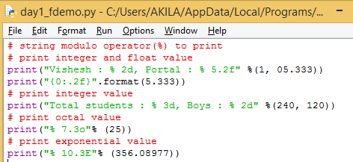
Format output-string modulo operator(%)
Vishesh : 1, Portal : 5.33
5.33
Total students : 240, Boys : 120
031
3.561E+02

Slide 22
Comment Line
Comment is text in a program's code.
Comments are used for documenting the code .
Comment lines will not be executed by the python interpreter.
Comments help make code easier to understand by explaining what is happening.

Slide 23
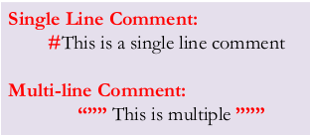
Comment Line
Comment Line Representation

Slide 24
Comment Line
Example code:
#variable declaration
name=“Ajay”
age = 18
'''printing the output
using the values stored in the variables'''
print(“Name :”, name)
print(“Age:”, age)
Output:
Name: Ajay
Age: 18

Slide 25
Digital cafe
URL: https://www.rajalakshmicolleges.net/moodle/
Credential
User name- college mailid
Password- Changeme@123

Slide 26
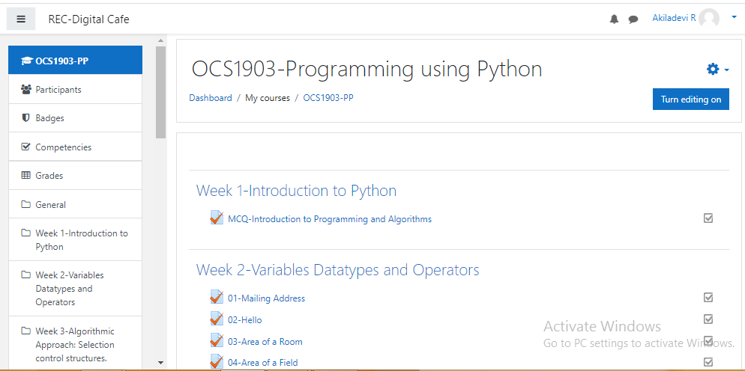
Course home page

Slide 27
Quiz
What is a correct syntax to output “REC" in Python?
print ”REC”
echo “REC”
print(“REC”)
echo(“REC”)
C

Slide 28
Quiz
How to insert COMMENTS in Python code?
#this is a comment
<! this is a comment>
“this is a comment”
A

Slide 29
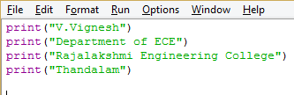
Program
Create a program that displays your name and complete mailing address. The address should be printed in the format that is normally used in the area where you live. Your program does not need to read any input from the user.
Sample Output:
V.Vignesh
Department of ECE
Rajalakshmi Engineering College
Thandalam

Slide 30


